Slide 1



UNIVERSITY INSTITUTE OF ENGINEERING
COMPUTER SCIENCE ENGINEERING
Bachelor of Engineering
Design and Analysis of Algorithms(CST-302/ITT-302)
Prepared By: Amrita Chaudhary (E8745)
Topic: Divide and Conquer
DISCOVER . LEARN . EMPOWER

Slide 2
Learning Objectives & Outcomes
Objective:
To understand the concept of Divide and conquer and how to solve binary search and min max problem using divide and conquer problem.
Outcome:
Student will understand
Divide and Problem
Binary Search
Min max Problem

Slide 3
Poll Question
The algorithm like quicksort, merge sort & binary search are based on:
Dynamic programming
Divide and Conquer.
Greedy method
Hashing

Slide 4
Divide and Conquer
Many algorithms are recursive in nature to solve a given problem recursively dealing with sub-problems.
In divide and conquer approach, a problem is divided into smaller problems, then the smaller problems are solved independently, and finally the solutions of smaller problems are combined into a solution for the large problem.

Slide 5
Divide and Conquer (continue..)
Generally, divide-and-conquer algorithms have three parts −
• Divide the problem into a number of sub-problems that are smaller instances of the same problem.
• Conquer the sub-problems by solving them recursively. If they are small enough, solve the sub-problems as base cases.
• Combine the solutions to the sub-problems into the solution for the original problem.

Slide 6
Pros and cons of Divide and Conquer Approach
Divide and conquer approach supports parallelism as sub-problems are independent. Hence, an algorithm, which is designed using this technique, can run on the multiprocessor system or in different machines simultaneously.
In this approach, most of the algorithms are designed using recursion, hence memory management is very high. For recursive function stack is used, where function state needs to be stored.

Slide 7
Application of Divide and Conquer Approach
Following are some problems, which are solved using divide and conquer approach.
• Finding the maximum and minimum of a sequence of numbers
• Strassen’s matrix multiplication
• Merge sort
• Binary search

Slide 8

Searching a Dictionary
To get a general sense of how the divide
and conquer strategy improves search,
consider how people find information in
a phone book or dictionary
  suppose you want to find “janissary” in
  a dictionary
  open the book near the middle
  the heading on the top left page is “kiwi”,
  so move back a small number of pages
  here you find “hypotenuse”, so move forward
  find “ichthyology”, move forward again
The number of pages you move gets
smaller (or at least adjusts in response
to the words you find)

Slide 9
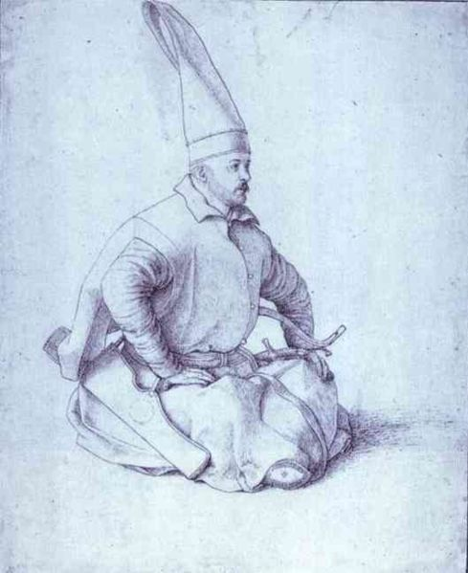
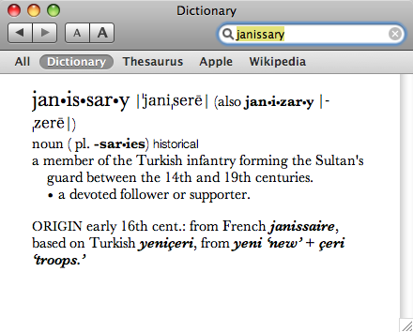
Searching a Dictionary
A detailed specification of this process:
the goal is to search for a word w in region of the book
the initial region is the entire book
at each step pick a word x in the middle of the current region
there are now two smaller regions: the part before x and the part after x
if w comes before x, repeat the search on the region before x, otherwise search the region following x (go back to step 3)
Note: at first a “region” is of a group of pages,
but eventually a region is a set of words on
a single page

Slide 10

Binary Search
The binary search algorithm uses the divide-and-conquer strategy to search through an array
The array must be sorted
  the “zeroing in” strategy for looking up a
  word in the dictionary won’t work it the
  words are not in alphabetical order
  binary search will not work unless the
  array is sorted

Slide 11
Binary Search (Contd.)
Problem:
Binary search can be performed on a sorted array. In this approach, the index of an element x is determined if the element belongs to the list of elements.
Solution:
In this algorithm, we want to find whether element x belongs to a set of numbers stored in an array numbers[ ]. Where l and r represent the left and right index of a sub-array in which searching operation should be performed.

Slide 12
Algorithm
Algorithm: Binary-Search(numbers[ ], x, l, r)
if l = r then
return l
else
m := ⌊(l + r) / 2⌋
if x ≤ numbers[m] then
return Binary-Search(numbers[ ], x, l, m)
else
return Binary-Search(numbers[ ], x, m+1, r)

Slide 13
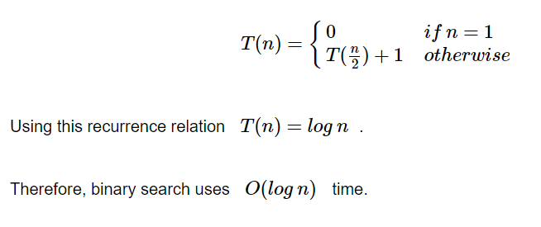
Analysis of Binary Search
Linear search runs in O(n) time. Whereas binary search produces the result in O(log n) time
Let T(n) be the number of comparisons in worst-case in an array of n elements.
Hence,

Slide 14
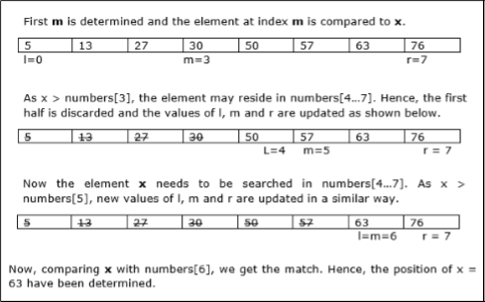
Example
In this example, we are going to search element 63.

Slide 15
Max-Min Problem
Problem Statement
The Max-Min Problem in algorithm analysis is finding the maximum and minimum value in an array.
Solution
To find the maximum and minimum numbers in a given array numbers[ ] of size n, the following algorithm can be used. First we are representing the naive method and then we will present divide and conquer approach.

Slide 16
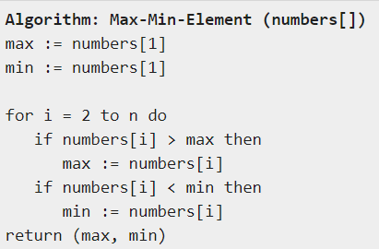
Naïve Method
Naïve method is a basic method to solve any problem. In this method, the maximum and minimum number can be found separately. To find the maximum and minimum numbers, the following straightforward algorithm can be used.

Slide 17
Analysis of Naïve Method
The number of comparison in Naive method is 2n - 2.
The number of comparisons can be reduced using the divide and conquer approach. Following is the technique.

Slide 18
Divide and Conquer Approach
In this approach, the array is divided into two halves. Then using recursive approach maximum and minimum numbers in each halves are found. Later, return the maximum of two maxima of each half and the minimum of two minima of each half.

Slide 19
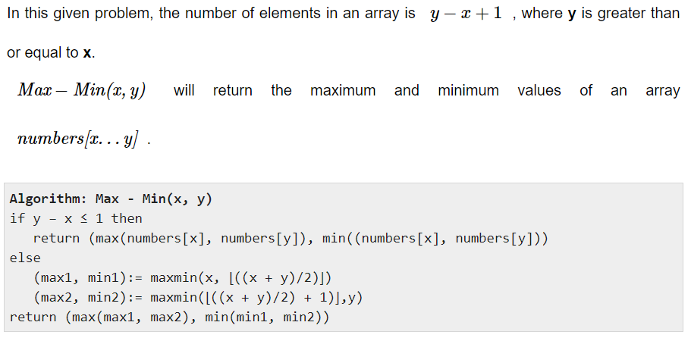

Slide 20
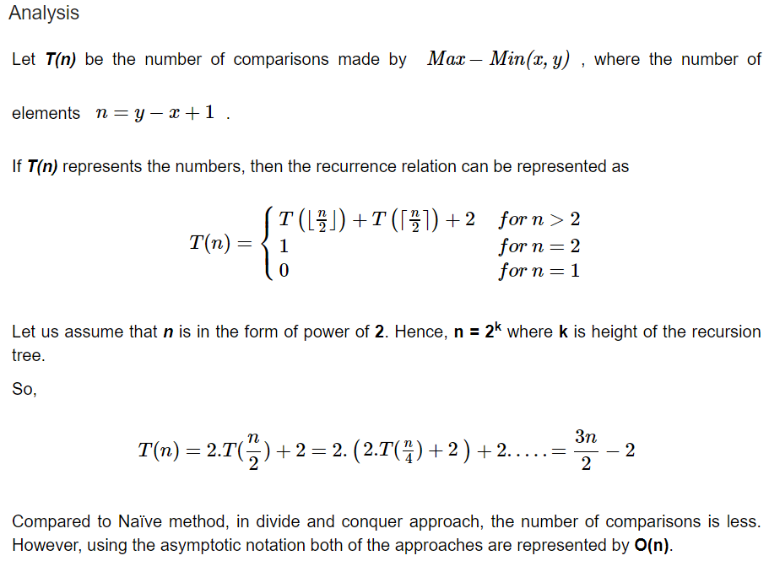

Slide 21
REFERENCES
Text books:
Cormen, Leiserson, Rivest, Stein, “Introduction to Algorithms”, Prentice Hall of India, 3rd edition 2012. problem, Graph coloring.
Websites:
https://www.tutorialspoint.com/design_and_analysis_of_algorithms/design_and_analysis_of_algorithms_max_min_problem.htm
https://www.tutorialspoint.com/design_and_analysis_of_algorithms/design_and_analysis_of_algorithms_binary_search.htm

Slide 22
Summary
  Divide and Conquer:
    Concept of Divide and conquer
    Binary Search
    Min Max Problem

Slide 23
THANK YOU

